Slide 1
Drones & UAV’s
A UAV (Unmanned Aerial Vehicle) or UAS (Unmanned Aerial System) is any aircraft that can navigate without a human pilot on board. Sometimes referred to as a drone.
With the advancements in the UAV industry today, there are more UAVs in the air than at any point in history.
Notes:
Jon

Slide 2
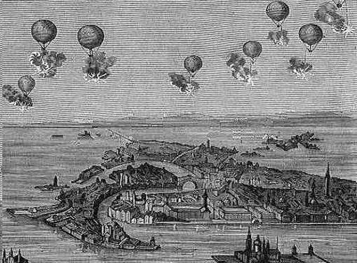
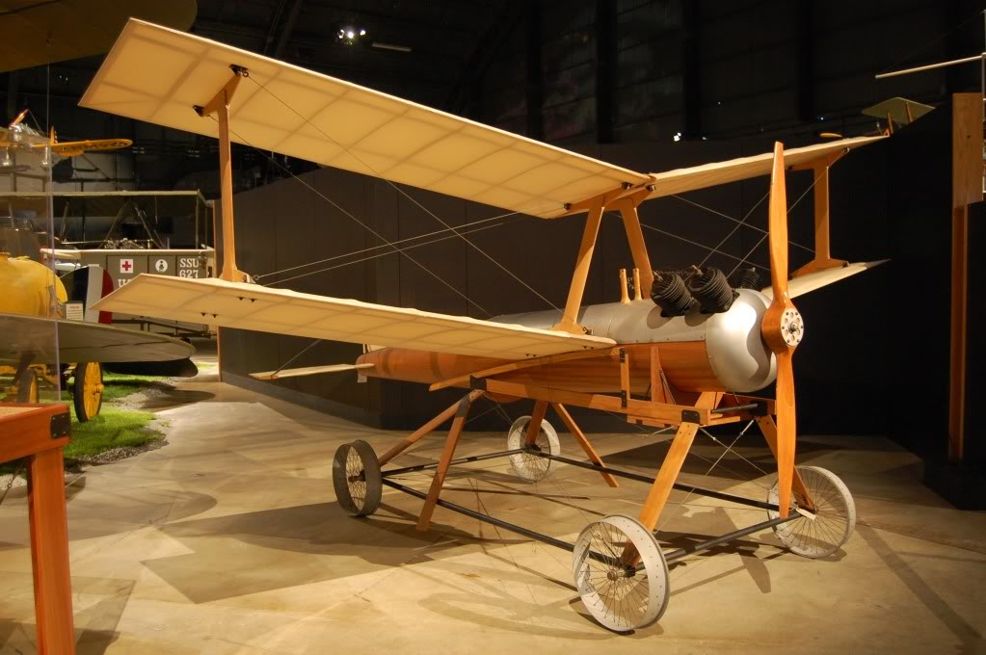
A brief look back
Austrian Balloon Bombs of 1849
The Kettering Bug was an unmanned aerial torpedo developed after world War I
Notes:
Jon

Slide 3
Who uses UAVs
The Military
NASA
NOAA
Cinematographers
Firefighters
Police Officers
Private GIS firms
And finally…hobbyists
Notes:
Jon

Slide 4
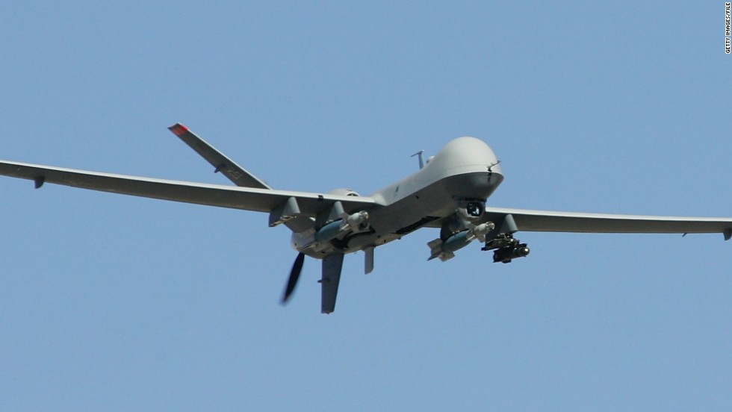
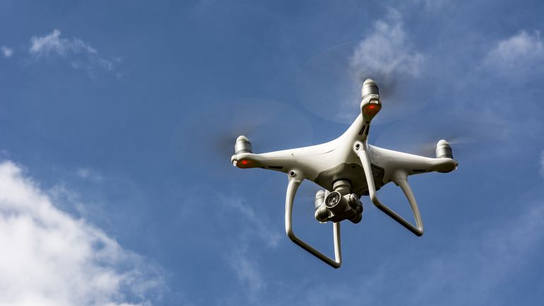
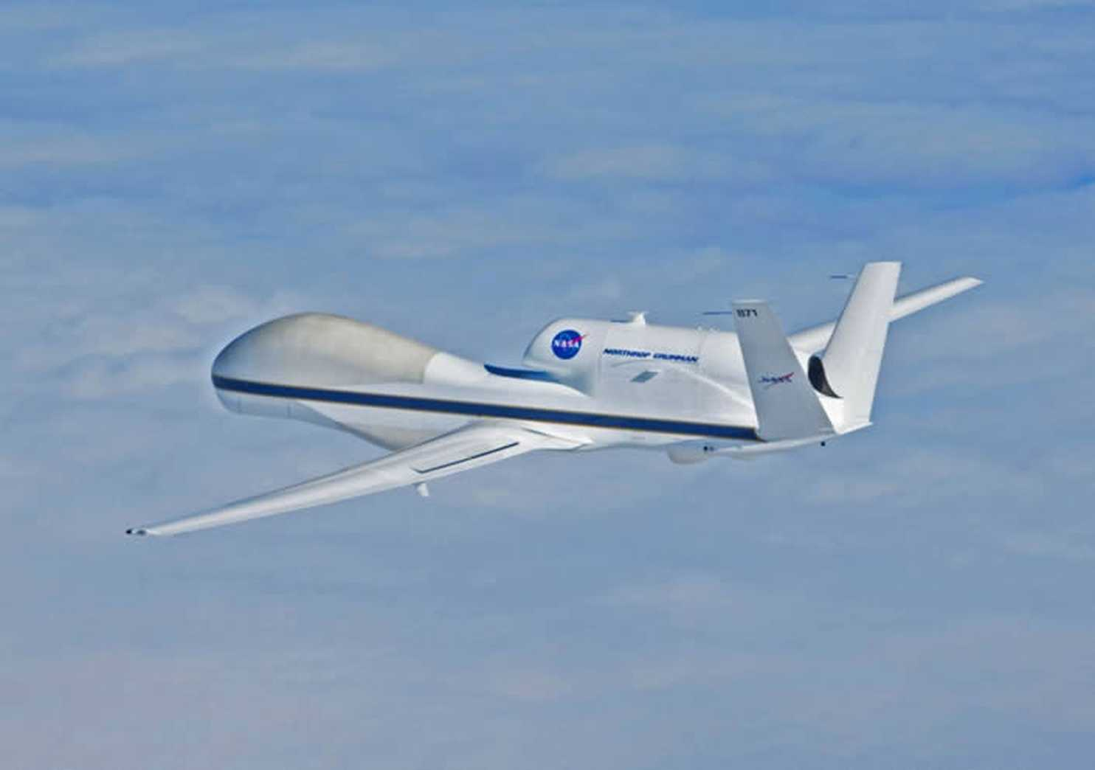
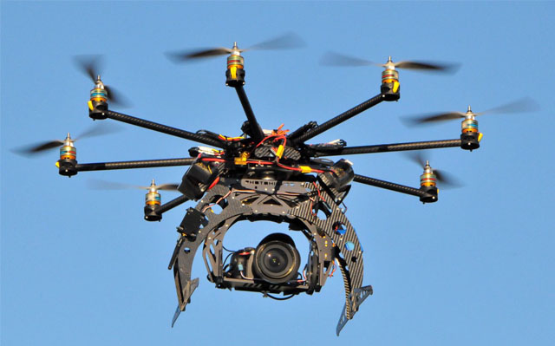
Examples of Modern UAVs
Notes:
Jon

Slide 5
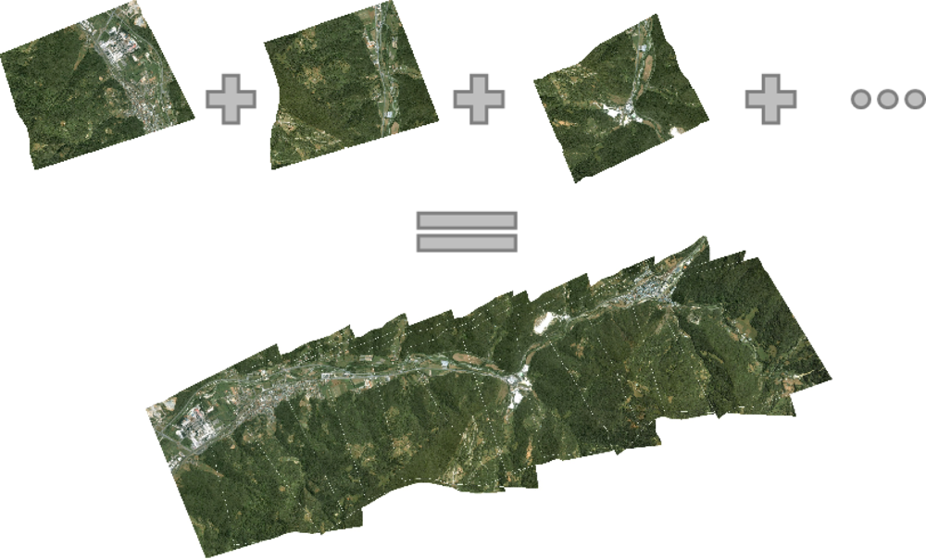
Creating Imagery from UAV’s
UAVs are programmed to fly a course at a set elevation. At a predetermined time interval, photographs are taken. These photos overlap enough to create a seamless image compiled of the collage of pictures.

Slide 6
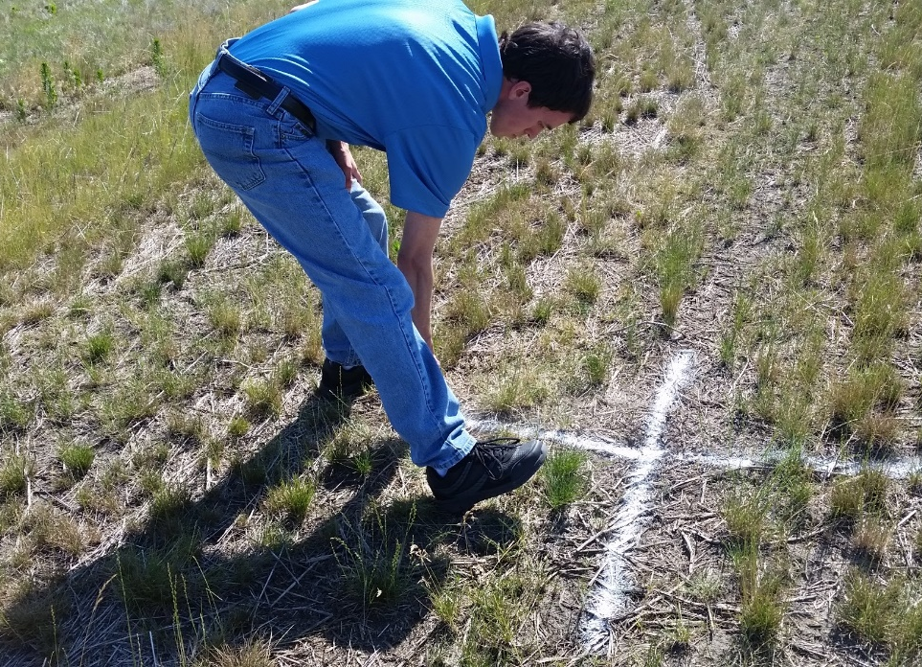
Why incorporate GCP’s?
By utilizing GCP’s, data accuracy can be increased to 1-2 inches as opposed to 3 feet or more in native georeferencing.

Slide 7
GPS your GPC’s, for better GIS
GPC’s are collected with high-accuracy, survey grade GPS. Points are then imported into the image processing software.

Slide 8
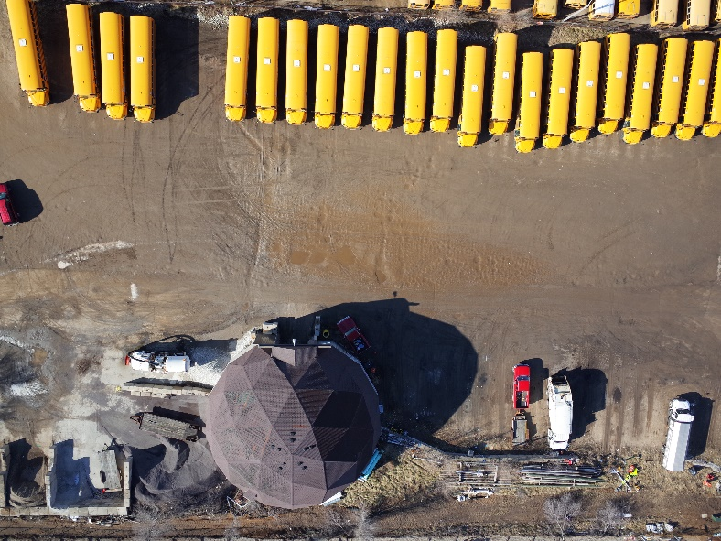
So how are GCP’s used?
After control points are collected and the aerial photography is brought into the system, points are manually selected from multiple photos to get achieve the high accuracy results.

Slide 9
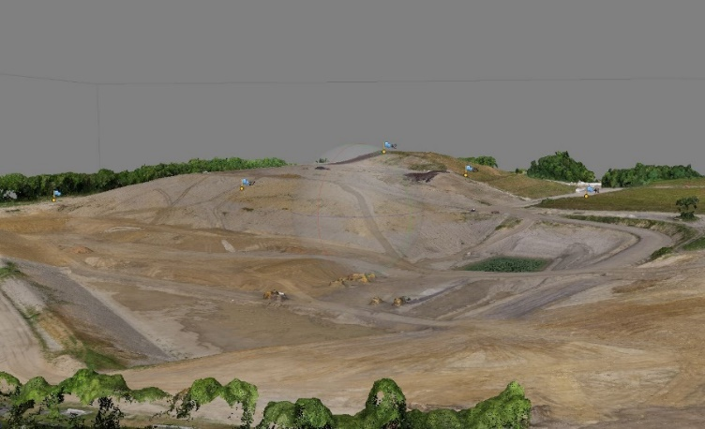
How can this data be used?
Data that has been collected by UAVs and has been manipulated via post processing, can yield many results such as elevation and volume calculations.

Slide 10
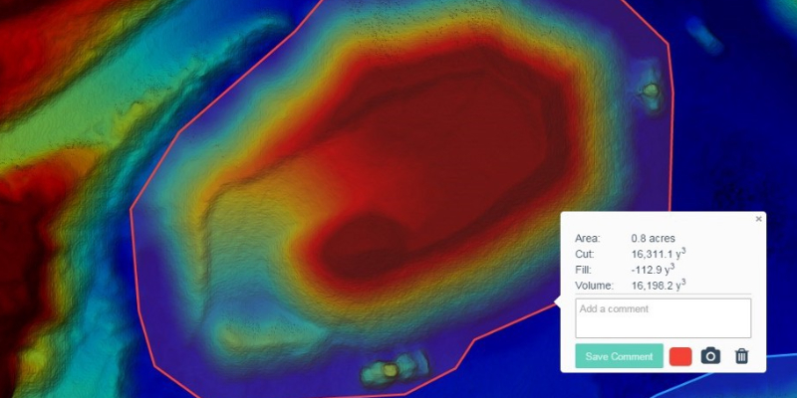
Applications for UAV’s
By utilizing UAVs to calculate volume, a quarry or gravel pit can better manage their inventory and stockpiles with increased accuracy and efficiency.

Slide 11
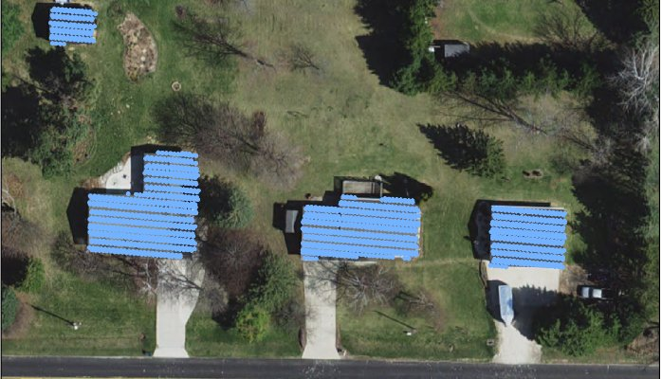
Applications for UAV’s
County assessors can utilize drone imagery to see if any structures have been built without documentation and proper permits thus resulting in more revenue via taxes.

Slide 12
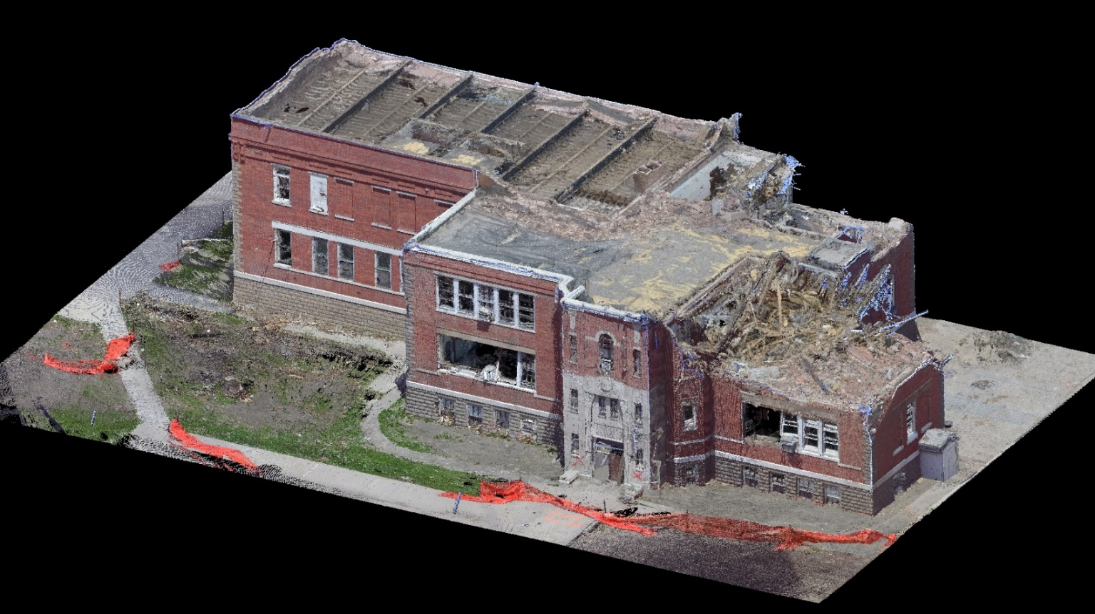
Applications for UAV’s
In the future it is predicted that UAVs will be used in emergency responses such as post hurricane devastation, wild fires, tornadoes, and much more. This will allow organizations the ability to better track damage and create response plans.

Slide 13
Need your own drone?

Slide 14
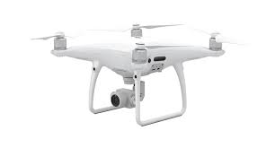
DJI Phantom 4 Pro
Cost = $1,600
Flight Time = 28 minutes
Coverage = 150 acres
Camera = 20MP Exmor R CMOS
Max Speed = 44 mph
Primary use: ameture videography & imagery

Slide 15
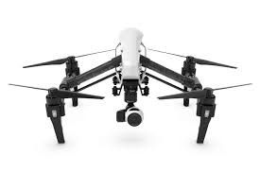
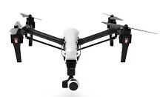
DJI Inspire 1
Cost = $2,800
Flight Time = 18 minutes
Coverage = 100 acres
Camera = 12MP & 16MP
Max Speed = 49 mph
Primary use: videography & inspection work

Slide 16
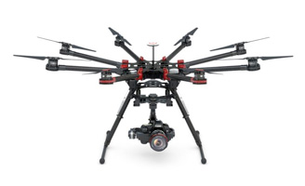
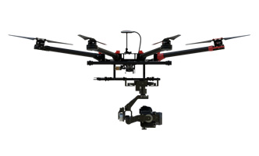
DJI Spreading Wings S1000
Cost (package)= $8,900
Flight Time = 15 minutes
Coverage = 100 acres
Camera = Professional grade
Max Speed = 58 mph
Primary use: Professional photos & industrial applications

Slide 17
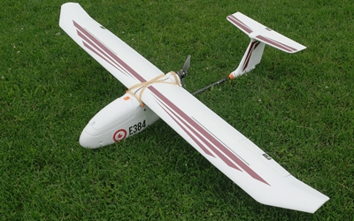
Event 38: E384
Cost (package)= $3,300
Flight Time = 100 minutes
Coverage = 400 acres
Camera = 18-28 MP
Max Speed = 29 mph
Primary use: surveying & mapping
Assembly video

Slide 18
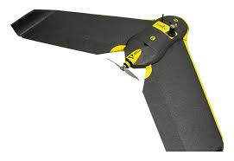
Sensefly Ebee RTK
Cost (package)= $25k
Flight Time = 40 minutes
Coverage = 300 acres
Camera = 20 MP
Max Speed = 40 mph
Primary use: Surveying & mapping
Takeoff video

Slide 19
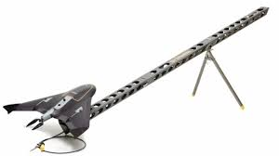
Trimble UX5
Cost (package)= $50k
Flight Time = 50 minutes
Coverage = 400 acres
Camera = 24 MP
Max Speed = 50 mph
Primary use: surveying & mapping
Photo of launch

Slide 20
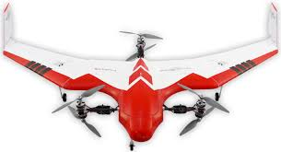
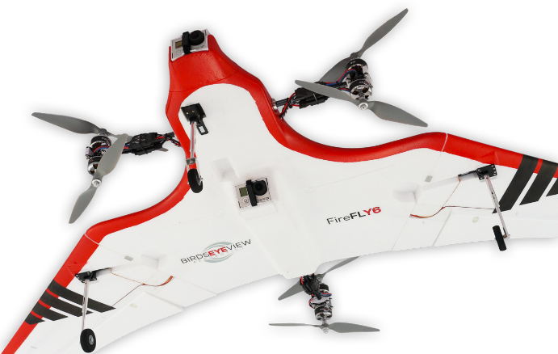
Firefly6
Cost (package)= $7,500
Flight Time = 45 minutes
Coverage = 400 acres
Camera = 24 MP
Max Speed = 40 mph
Primary use: surveying & mapping

Slide 21
Choosing the right drone
Let application drive the purchase decision (ag, site survey, inspection work, etc.)
Use popular flight controllers and platforms
Spend twice as much time choosing the sensor package as you are for the bird
Can the platform carry different types of sensors

Slide 22
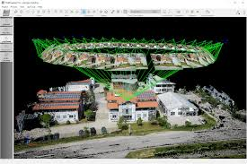
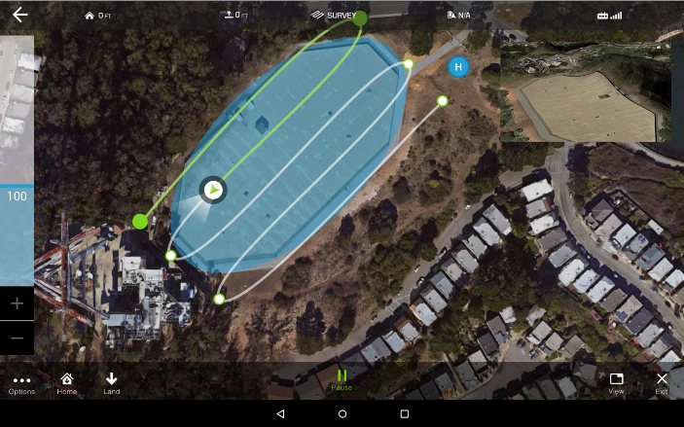
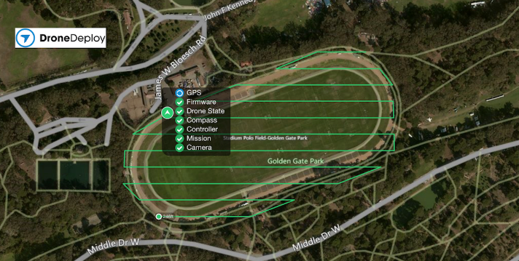
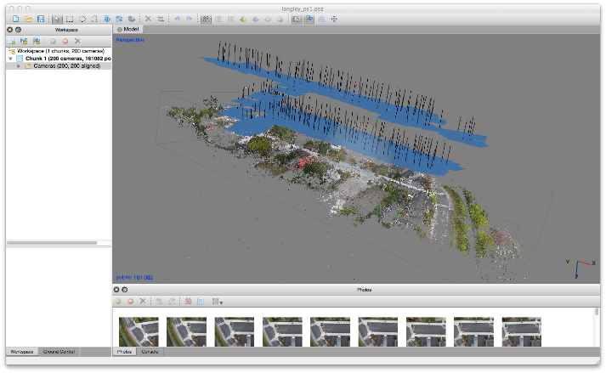
Different UAV processing tools
Pix 4D
Drone Deploy Drone2Map
Agisoft

Slide 23
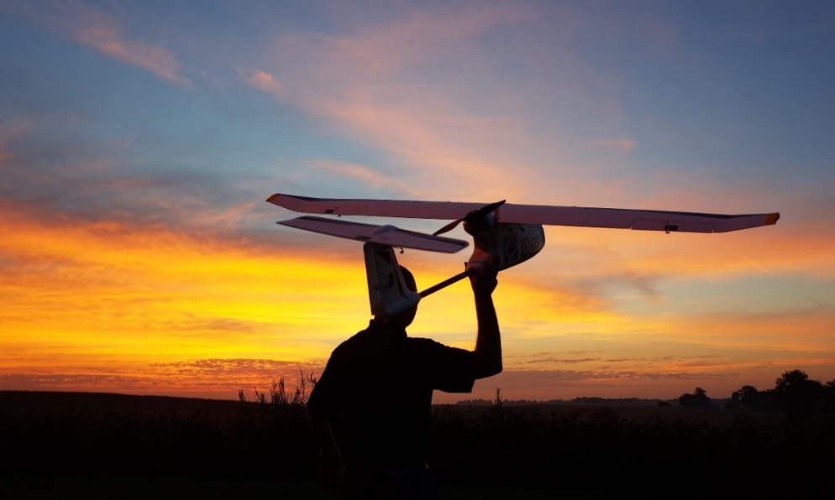
Why should you care?
UAVs are continuously becoming more powerful, efficient, and cheaper to operate.
If you are in the geospatial field, odds are that you are going to be utilizing UAVs throughout your careers.

Slide 24
UAVs in GIS: Closing
The geospatial field is constantly evolving. We are in the midst of a mapping revolution that is fueled by ever changing and evolving technology.
The use of UAVs in the geospatial world is a powerful tool that is only going to increase in power and implementation. It is in your best interest to learn the skills and technology of this field so you can emerge as the top candidate for this brave new world.

Slide 25
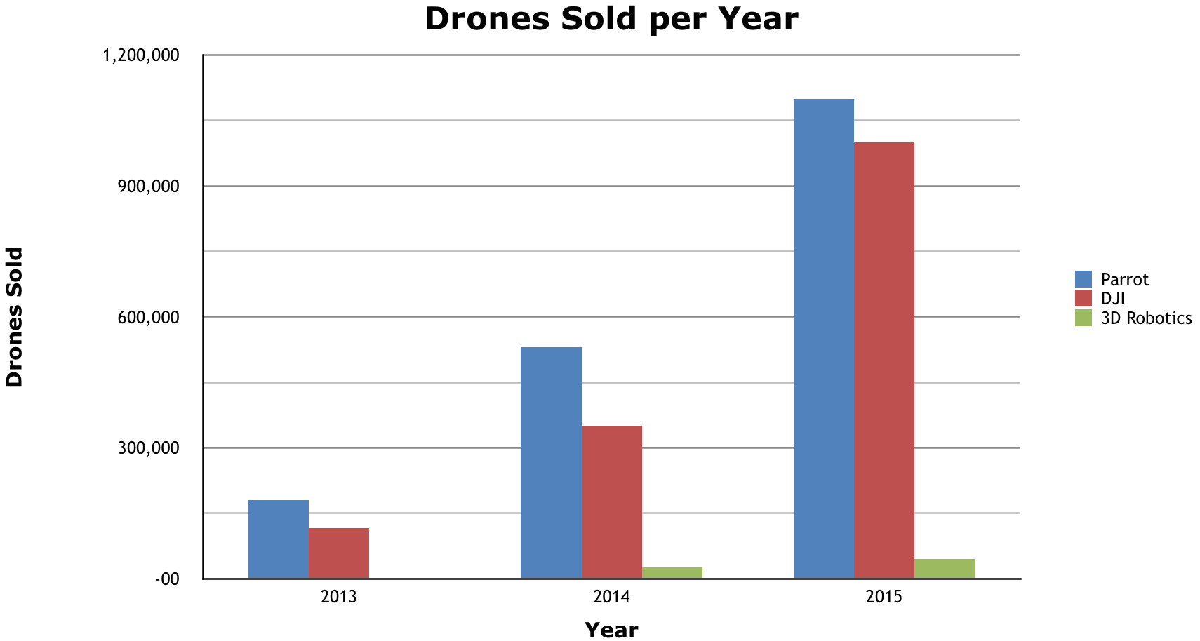
Where are drones heading?

Slide 26
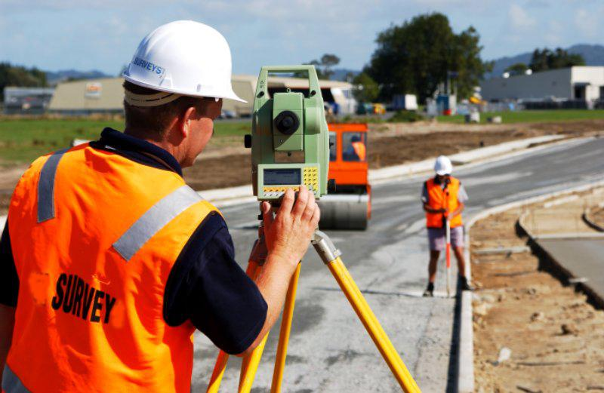
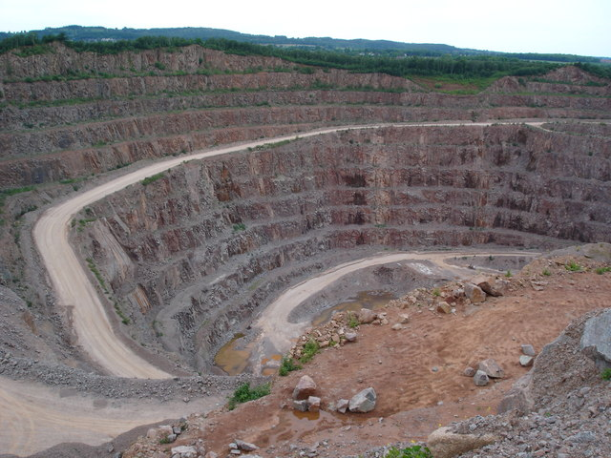
Why is this important?
Utilizing drones for this manner is beneficial in multiple ways. One main advantage is the tremendous saving of time spent for jobs. What used to take days to complete, now takes hours.

Slide 27
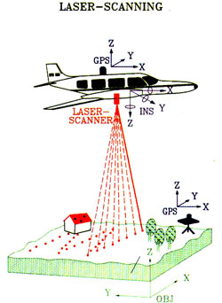
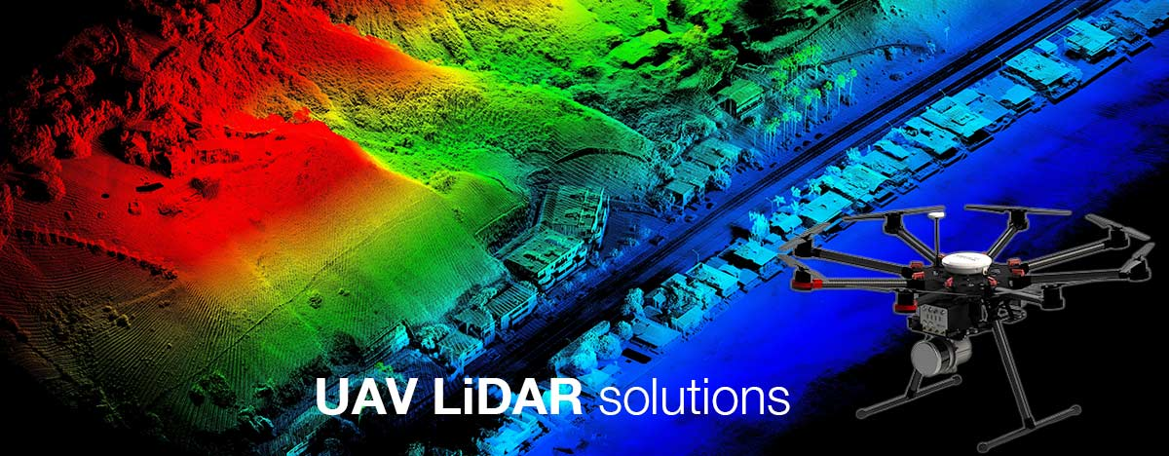
Why is this important?
As the technology continues to improve, the cost savings and enhanced data collection will continue to improve as well. Jobs that used expensive planes in the past are now able to be done via UAV.

Slide 28
How to become a UAS pilot?
Short answer…yes and no. Yes anyone can become a commercial UAV pilot, but you must acquire your UAV pilot license from the FAA.
This requires passing a general pilot test which covers many of the same facets of the sport pilot exam.

Slide 29
Project Portfolio
This map shows a collection of recent drone flights and was inserted using the Esri Maps for Office accessing a web map through our ArcGIS Online organizational account.

