Slide 1
What’s New Arcgis 10.5.1
Or 10.5 in general

Slide 2
ArcGIS Enterprise
ArcGIS Desktop Map/Catalog/Pro
Other Tools & Apps

Slide 3
Arcgis enterprise
Datastore
ArcGIS Server
Portal
WebAdaptor

Slide 4
Server Roles
GIS Server
Image Server
Geoevent Server
Geoanalytics Server
Business Analyst Server

Slide 5
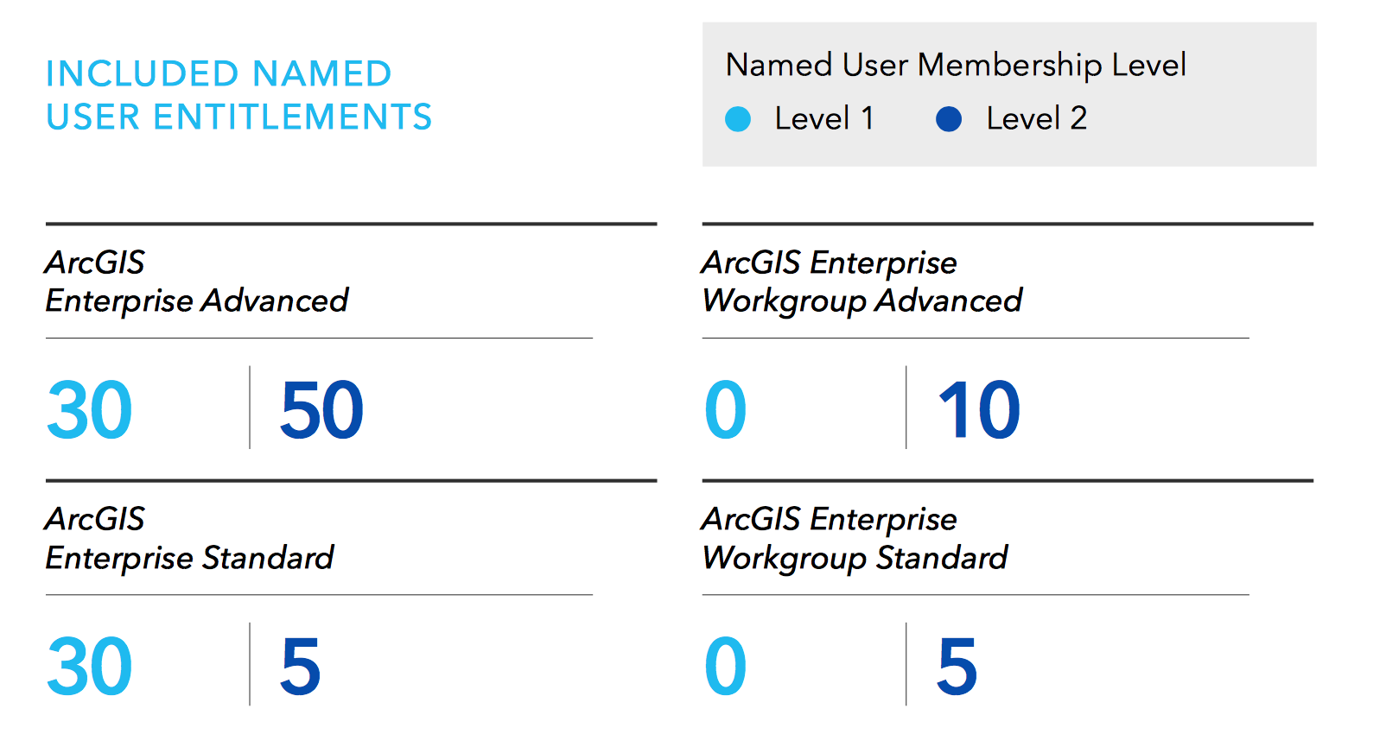
Named users
http://www.esri.com/library/brochures/pdfs/arcgis-enterprise-functionality-matrix.pdf

Slide 6
At 10.5.1 we have
“Enterprise Builder”
Easy Deployment onto a server
Chef Cookbooks
Cloud Deployment Options

Slide 7
Arcgis Desktop
ArcMap / ArcCatalog lifecycle
Version | Release Date | General Availability | Extended Support | Mature Support | Retired | Release Notes
10.5.1 | June 29, 2017 | Jun 2017 - Nov 2018 | Dec 2018 - Nov 2020 | Dec 2020 - Nov 2022 | December 01, 2022 | View
10.5 | December 15, 2016 | Dec 2016 - Nov 2018 | Dec 2018 - Nov 2020 | Dec 2020 - Nov 2022 | December 01, 2022 | View
10.4.1 | May 31, 2016 | May 2016 - Jan 2018 | Feb 2018 - Jan 2020 | Feb 2020 - Jan 2022 | February 01, 2022 | View
10.4 | February 18, 2016 | Feb 2016 - Jan 2018 | Feb 2018 - Jan 2020 | Feb 2020 - Jan 2022 | February 01, 2022 | View
10.3.1 | May 13, 2015 | May 2015 - Nov 2016 | Dec 2016 - Nov 2018 | Dec 2018 - Nov 2020 | December 01, 2020 | View
10.3 | December 10, 2014 | Dec 2014 - Nov 2016 | Dec 2016 - Nov 2018 | Dec 2018 - Nov 2020 | December 01, 2020 | -

Slide 8
Arcgis Desktop
ArcGIS Pro, ArcPro, Pro
  http://pro.arcgis.com/en/pro-app/get-started
        Demo.

Slide 9
Other tools and Apps
Collector
Maps for Office
Survey123
Workforce
Insights

Slide 10
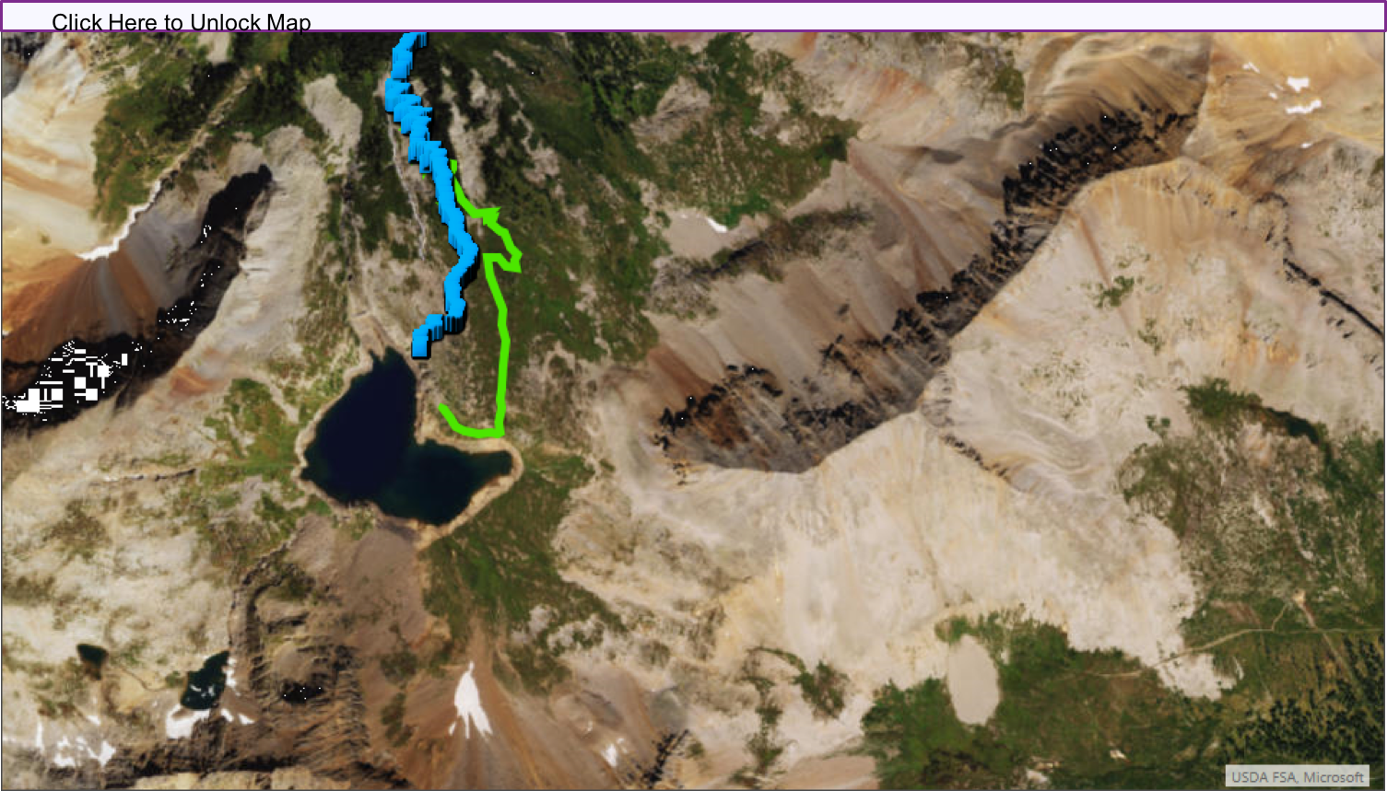
Maps for office

