Slide 1
ArcPro & 10.5
Unknown unknowns

Slide 2
ArcPro or ArcGIS pro

Slide 3
http://server.arcgis.com/en/server/latest/get-started/windows/what-s-new-in-arcgis-for-server.htm

Slide 4
http://www.esri.com/seminars/arcgis-user-seminar

Slide 5
http://pro.arcgis.com/en/pro-app/

Slide 6
Solutions Deployment Tool https://blogs.esri.com/esri/arcgis/2016/12/09/arcgis-solutions-deployment-tool-sneak-peek/

Slide 10
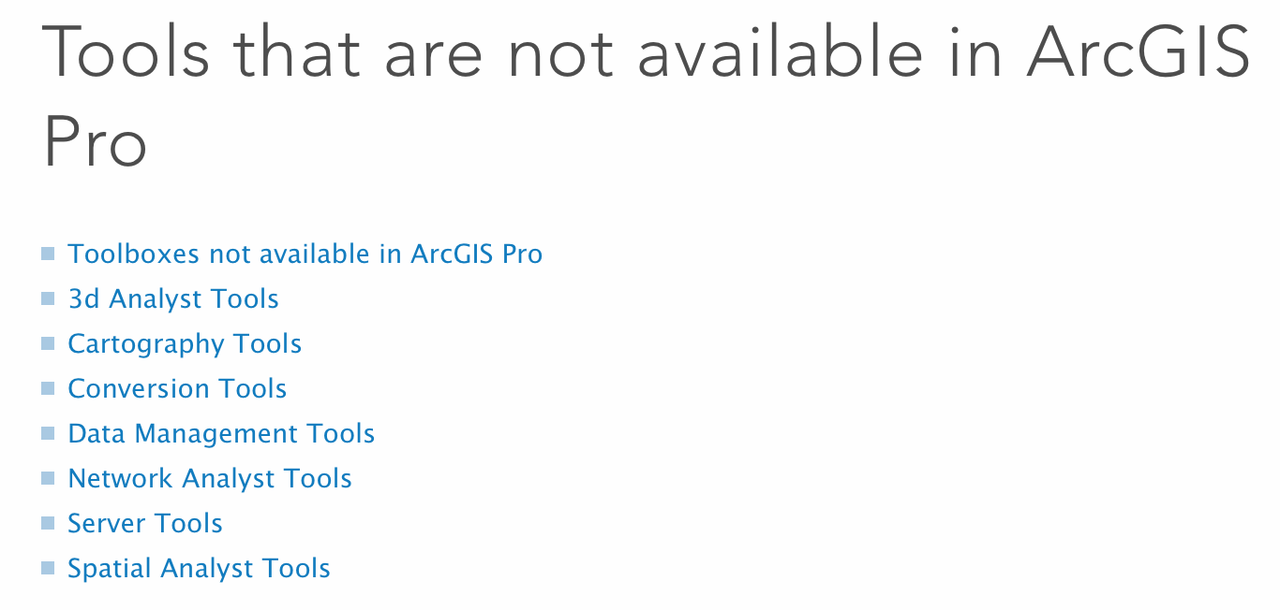
https://pro.arcgis.com/en/pro-app/tool-reference/appendices/unavailable-tools.htm

